Slide 1
Generative adversarial network

Slide 2
GAN
A generative adversarial network (GAN) is a class of machine learning systems invented by Ian Godfellow and his colleagues in 2014.
Two networks:
Generative network
Discriminative network
The generative network generates candidates while the discriminative network evaluates them.

Slide 3
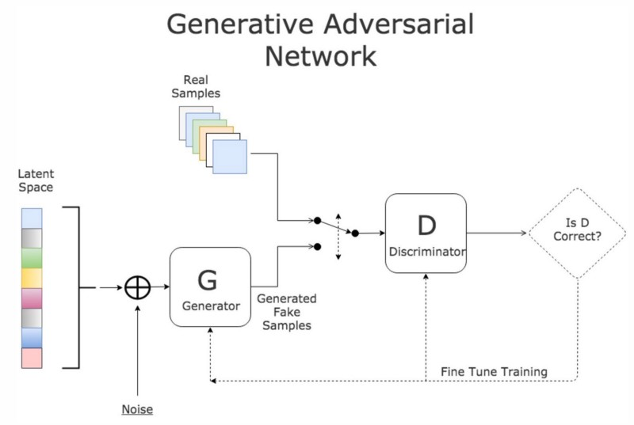
GAn

Slide 4
Facebook’s AI research director Yann LeCun called adversarial training “the most interesting idea in the last 10 years in ML.”

Slide 5
Method
The generator takes in random numbers and returns an image.
This generated image is fed into the discriminator alongside a stream of images taken from the actual, ground-truth dataset.
The discriminator takes in both real and fake images and returns probabilities, a number between 0 and 1, with 1 representing a prediction of authenticity and 0 representing fake.
Feedback loop:
The discriminator is in a feedback loop with the ground truth of the images, which we know.
The generator is in a feedback loop with the discriminator.

Slide 6
Applications
Text to image generation
Image to image translation
Increasing image resolution
Predicting next video frame
Face Apps

Slide 7
Our project
Our project is a game to identify the fake images from a set of real (trained images) and fake (images generated by GAN) images.
The training set consists of classes like dogs.
The discriminator and generator are trained parallelly.
The generated images are stored.
From the set of real and fake images the user has to identify fake images.
The score is displayed in a leaderboard.
The efficiency of our model is evaluated from the scores.

Slide 8
OPEN source tools
Python (programming language)
PyTorch (open source machine learning library in python)
Flask (micro web framework in Python)

Slide 9
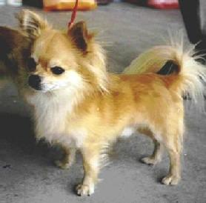
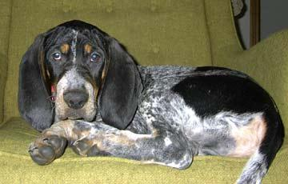
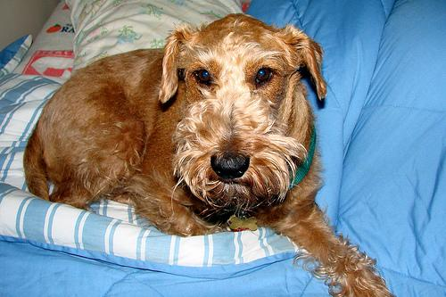



Sample images
Trained images
Generated images

Slide 10
Thank You

